Slide 1
Domain Name System(DNS)

Slide 2
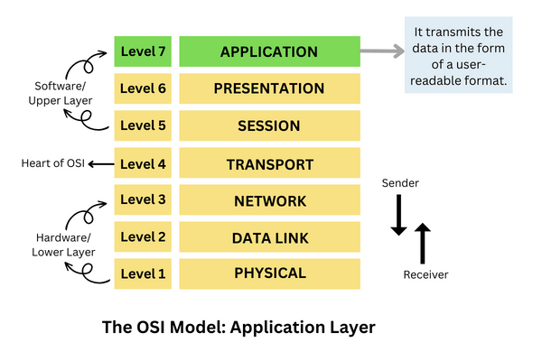
Application Layer

Slide 3
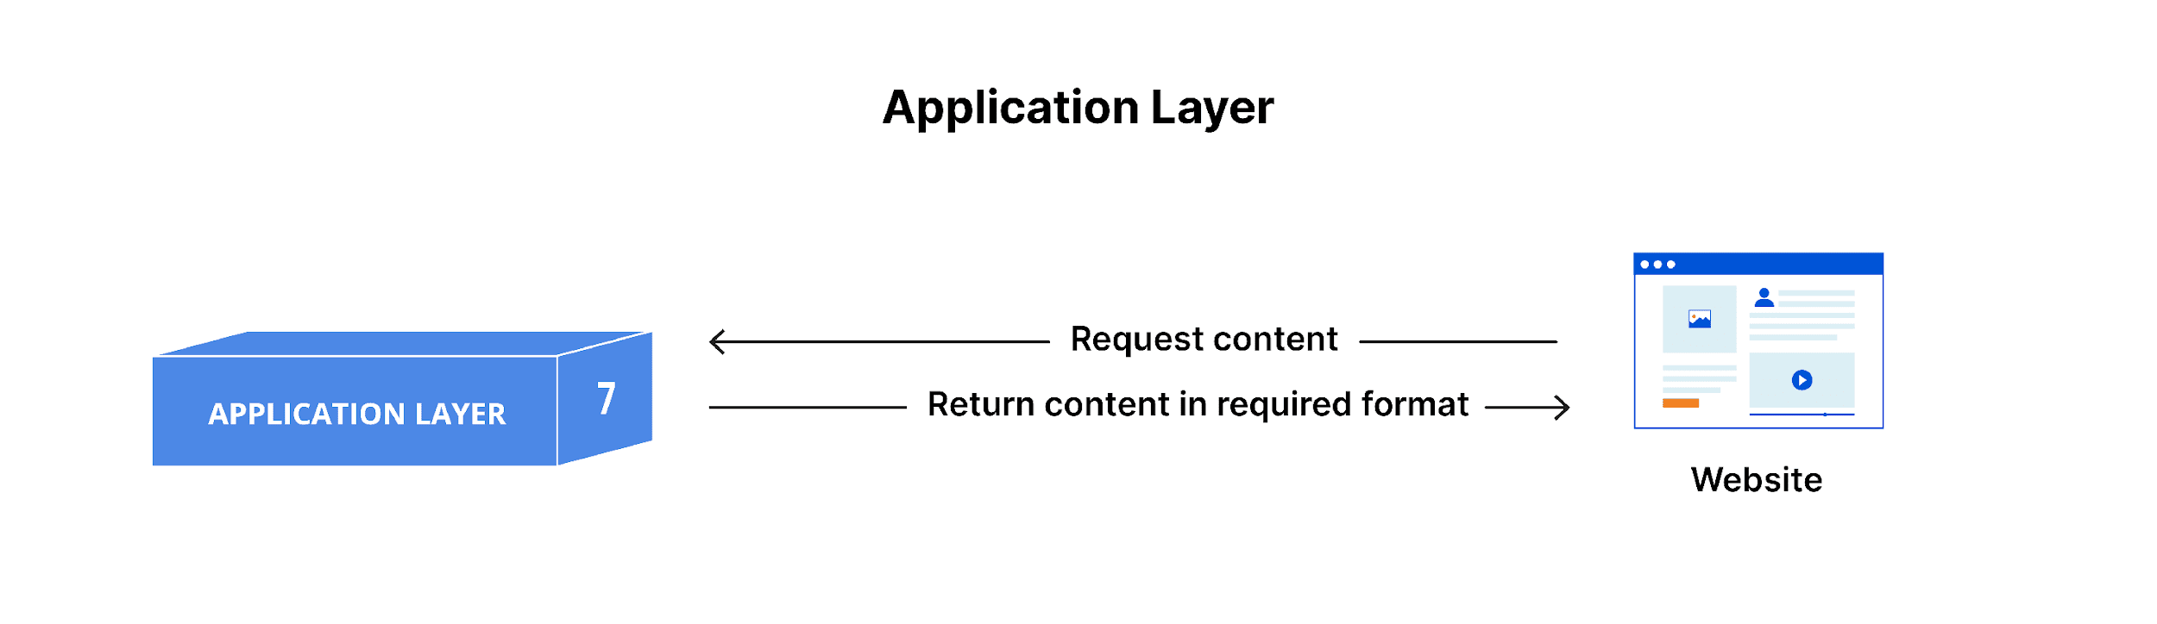
Application Layer

Slide 4
Application Layer protocols
SMTP
HTTP
DNS
FTP
TELNET

Slide 5
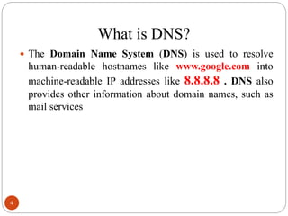
DNS

Slide 6
Namespace
To be unambiguous, the names assigned to machines must be carefully selected from a name space with complete control over the binding between the names and IP addresses.
Types
i.Flat namespace
ii.Hierarchical namespace

Slide 7
Hierarchical namespace
To have a hierarchical name space, a domain name space was designed. In this design the names are defined in an inverted-tree structure with the root at the top. The tree can have only 128 levels: level 0 (root) to level 127.

Slide 8
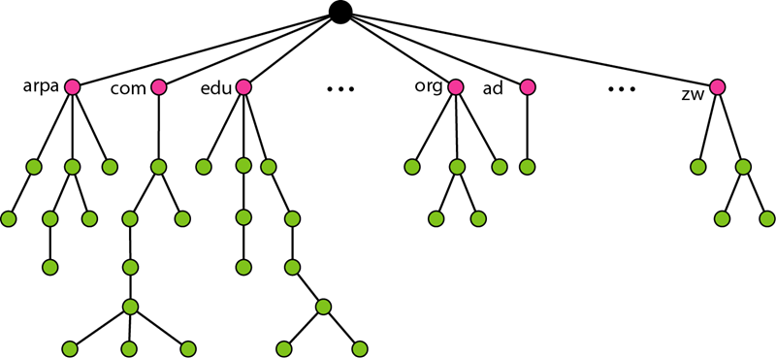
Domain name Space

Slide 9
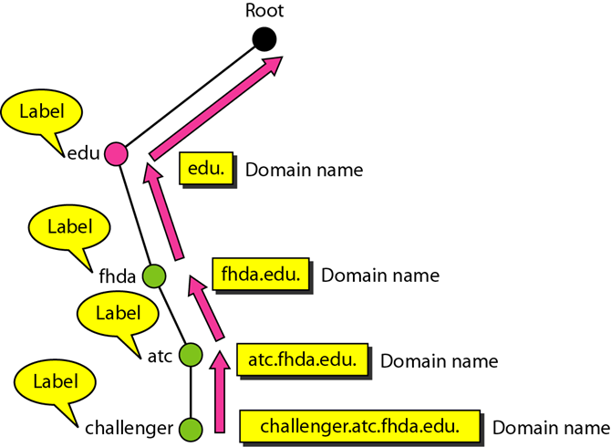
DNS

Slide 10

Domain names

Slide 11
Domain name
A fully-qualified domain name (FQDN) is a domain name that specifies the complete path to a particular domain in the Domain Name System (DNS) hierarchy.

Slide 12
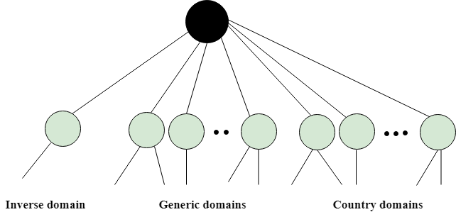
Types of Domains
The domain name space is divided into three different sections: generic domains, country domains, and inverse domain.

Slide 13
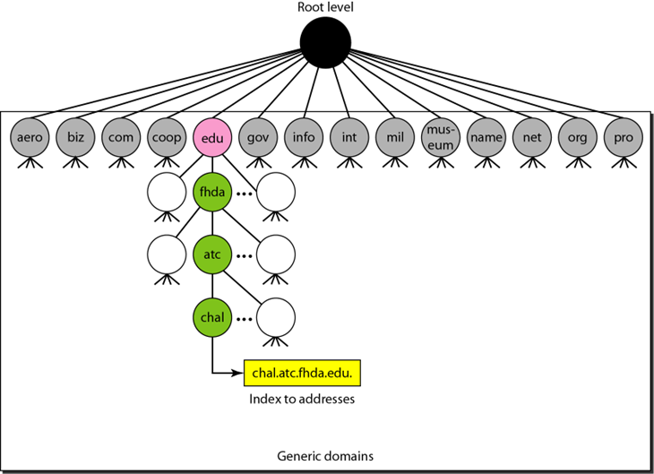
Generic Domains

Slide 14
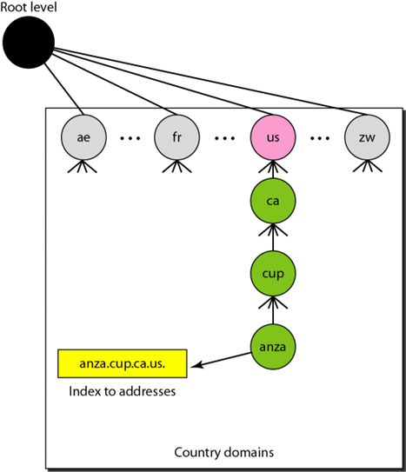
Country Domains

Slide 15
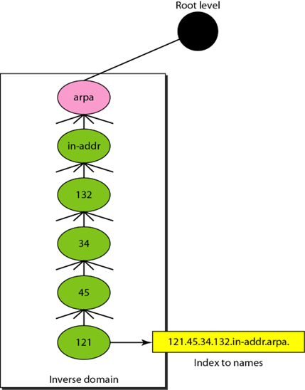
Inverse Domain

Slide 16
Types of Domain
Generic domains: .com(commercial), .edu(educational), .mil(military), .org(nonprofit organization), .net(similar to commercial) all these are generic domains.
Country domain: .in (India) .us .uk
Inverse domain: if we want to know what is the domain name of the website. Ip to domain name mapping. So DNS can provide both the mapping for example to find the IP addresses of geeksforgeeks.org then we have to typ

Slide 17
Working of DNS
Mapping a name to an address or an address to a name is called name-address resolution.

Slide 18
Working of DNS
DNS is a client/server network communication protocol. DNS clients send requests to the. server while DNS servers send responses to the client.
Client requests contain a name which is converted into an IP address known as a forward DNS lookups while requests containing an IP address which is converted into a name known as reverse DNS lookups.
DNS implements a distributed database to store the name of all the hosts available on the internet.
If a client like a web browser sends a request containing a hostname, then a piece of software such as DNS resolver sends a request to the DNS server to obtain the IP address of a hostname. If DNS server does not contain the IP address associated with a hostname, then it forwards the request to another DNS server. If IP address has arrived at the resolver, which in turn completes the request over the internet protocol.

Slide 19
Thank You

